Slide 1
Using Mentimeter to gauge and engage science students in information skills sessions.
What is Mentimeter?
Our Science Students
How we use Mentimeter
What we’ve discovered
Our Future Plans
Emma Burnett, Rachel White & Leanne Workman
Library Information Consultants from Royal Holloway, University of London

Slide 2
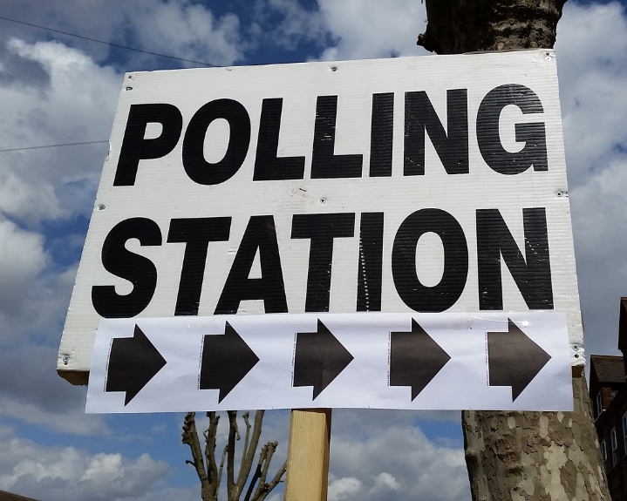
What is Mentimeter?
Mentimeter is an easy-to-use, cloud-based polling tool. It does not require an app; the teacher just needs to log in & present the poll, and users simply use their own devices using a short code.
It helps teachers to interact with the class, engage them in the discussion and gauge their knowledge & understanding.
Features of Mentimeter
Try a Mentimeter Poll!
Further Information
CC-BY: Image courtesy of RachelH_.

Slide 3
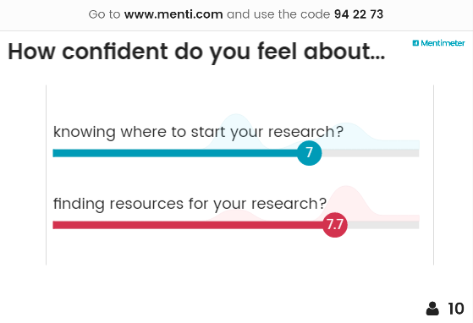
Features of Mentimeter
A variety of polling styles – such as multiple choice or image choice questions, word clouds, quizzes, scales, open ended text entry…
Unlimited number of votes
It is free for a maximum of two questions per presentation (but if you slyly email colleagues with a link to sign up to Mentimeter, the more questions you get to add!)
Can view past results (top tip here: “ask questions again” to keep previous results!)
There’s a Powerpoint plug in
It also easily embeds into LibGuides and other webpages

Slide 4
Try a mentimeter poll

Slide 8
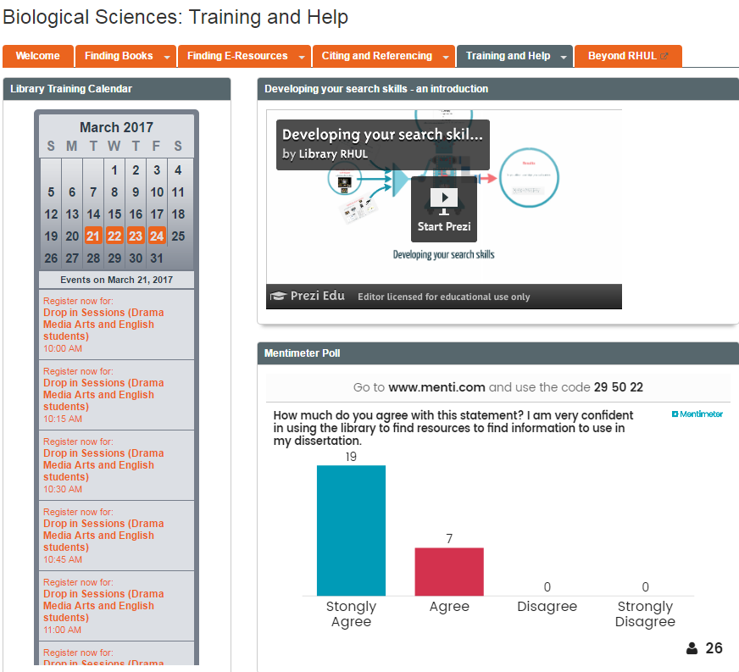
Further Information
For information on how to use Mentimeter and
quick start guides, click on the information icon.
Mentimeter polls can be embedded into LibGuides like this one>
For details on how to embed Mentimeter into Powerpoint, click here.

Slide 9
Our Science Students
Our aim has been to change students from passive/bored students like Buffy to interested investigators like Angela Lansbury!
Royal Holloway, University of London was founded by Thomas Holloway in the late 19th century. It was among the first institutions in the UK to give women access to higher education. There are 26 subject areas divided into 3 faculties: Arts and Social Sciences; Management, Economics and Law; and Science.
Science students make up about 30% of our student population and historically the Science faculty have largely been less engaged with information literacy and skills than the other faculties. The students have also proved difficult to engage.

Slide 10
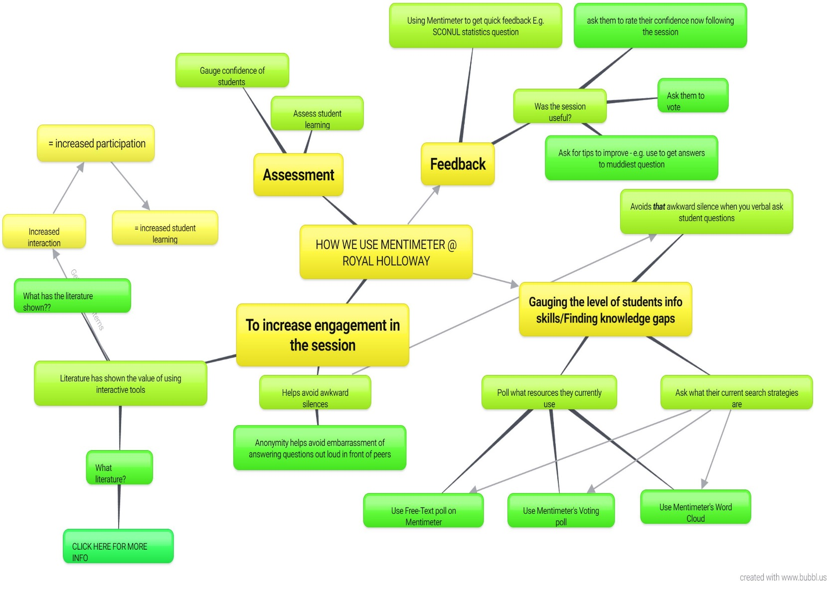
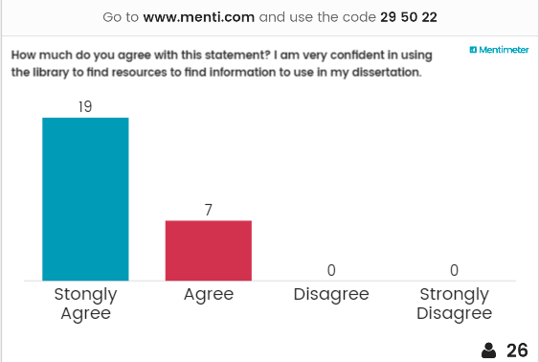
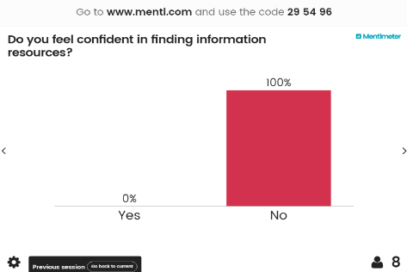
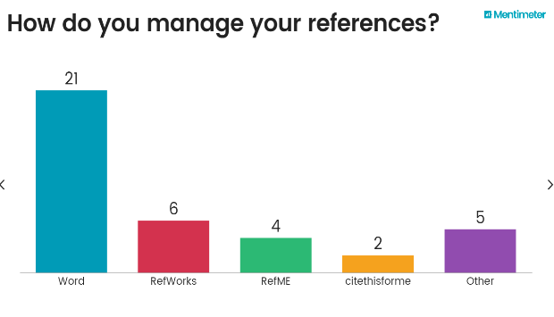
How we use Mentimeter at Royal Holloway

Slide 12
What does the literature say?!
Here are the key themes found in our quick lit overview on the use and value of interactive polling tools in teaching…
Get instant feedback and responses = the technology acts as a facilitator to open up discussion and gauges student’s interaction with the topic, which can help ensure the content is reaching & being understood by the students
Interactivity in sessions helps avoid lack of participation by students by breaking up the sessions and asking students for their interaction
The anonymity of answering polls helps put students at ease (students can feel self-conscious or uncomfortable answering verbal questions)
Interactive polling tools help produce active learning and positive learning outcomes
Polling tools help provide on-the-spot assessment of learning goals
It can provide information on the current level of students’ knowledge in this field and help instructor to fill in the gaps
Polling helps students reflect on their learning and creates a self-awareness of their understanding of a topic.
CC-BY-NC: Image courtesy of StephhxBby
Quick Ref List:
Burke, R., Coles, K., Downes, S. & Woods, E. (2015) Teachmeet handout: Using Socrative polls in IL teaching. [PDF Poster]
Corcos, E. & Monty, V. (2008) Interactivity in Library Presentations using a personal response system. [Article]
Gewirtz, S. (2012) Make your library instruction interactive with Poll Everywhere. [Article]
Glassman, N. R. (2015) Texting during class: Audience response systems. [Article]
Greenwich Connect (2016) Using Moodle quizzes, polls and survey activities in Teaching and Learning. [Blog post]
Hoppenfeld, J. (2012) Keeping students engaged with web-based polling in the library instruction session. [Article]
Jones, M. (2014) Implementation Plan – Polly Everywhere to Engage. [Prezi presentation]
O'Connor, K. (2015) Interactive library instruction: The use of Poll Everywhere as an assessment tool. [Article]
Osterman, A. C. (2007) Student response systems: keeping the students engaged. [Article]
Peachey, N. (2012) Instant opinion polls in the classroom. [Blog]
Snyder, A. & Hallam-Miller, J. (2014) Using polls to gauge and engage. [PDF Poster]

Slide 13
What we’ve found out
Increases engagement and halts passive learning/encourages active learning
Honest feedback is easier to come by!
Awkward silences in response to verbal questions, which were particularly prevalent in sessions with science students have been avoided as anonymity of polls has encouraged students to answer and engage in the session
Finding & filling students’ knowledge gaps – let the students guide the emphasis of the session
Works better than other tools such as Socrative – no need to download an app or register (we have had issues of people finding the right Socrative room due to not spelling RHULLibrary right!)
It shows real time results (and this usually gets a reaction from the students, especially when they see their answers going up on the screen, thus provoking discussion!)
CC-BY-NC-SA: Image courtesy of sleepymyf

Slide 14
Our Future Plans
Branch Out
Increase usage of Mentimeter across the Science Faculty (currently used widely in 4 of 8 science departments)
Expand usage beyond the Science faculty
Use the full range of questions types on Mentimeter in order to evaluate which gives the best summative and formative assessment and feedback
2) Collate Data
Gather student feedback from polls on whether learning outcomes have been achieved
What has worked best? What hasn’t worked?
3) Review
Evaluate feedback data and draw conclusions on how students in different subject fields engage with polls
Allow this to inform our use of polls in teaching
Branch Out
Collate Data
Review

